Slide 1

Department of Computer Science and Engineering Accuracy and Efficiency Gains in Waste Classification Through Continuous Learning and Advanced Techniques
PRESENTED BY
Munamala Sreya Reddy (21471A05N8)
Meena Madhavi (22475A0522)
Pothabattini Nikhitha (22475A0504)
Under the Guidance of,
Dr.M.Sathyam Reddy _{M.Tech}
Designation,
Department of Computer Science and Engineering,
Narasaraopeta Engineering College (Autonomous), Narasaraopet- 522 601.
Review No.
Department of CSE

Slide 2
OUTLINE
Abstract
Introduction
Literature Survey
Research Gaps
Problem Statement
Objectives
Pre processing
Methodology
Comparitive Analysis
Methods and Models
Result and Analysis
Front End Screens
Conclusion and FutureScope
References
Questions and Answers
Acknowledgement
Review No.
Department of CSE

Slide 3
ABSTRACT
Efficient management of waste is crucial for sustainable development, especially with the ever-growing volume of municipal and household waste. Existing waste classification systems suffer from several challenges, including low recognition accuracy, class imbalance, and difficulty in scaling for real-world conditions. This paper proposes a solution by utilizing the InceptionV3 deep learning architecture and optimizing key hyperparameters using Multi-Objective Beluga Whale Optimization (MBWO) on the TrashNet dataset. The optimized system achieves impressive performance metrics, such as 97.75% accuracy, 99.55% specificity, and outperforms traditional methods with 98.88% accuracy. It categorizes waste into materials like paper, plastic, metal, and glass for efficient recycling and reduced landfill use.
Review No.
Department of CSE

Slide 4
INTRODUCTION
The project presented in the document focuses on an advanced waste classification system that utilizes deep learning and optimization techniques to improve efficiency in waste management. The system addresses challenges faced by traditional waste classification systems, such as low accuracy, class imbalance, and scalability issues. By integrating InceptionV3, with Multi-Objective Beluga Whale Optimization (MBWO) for hyperparameter tuning, the proposed model achieves outstanding performance metrics, including 97.75% accuracy. It effectively classifies waste materials into categories such as paper, plastic, metal, and glass, supporting efficient recycling processes and reducing dependence on landfills.
The project utilizes techniques like data augmentation and oversampling to mitigate class imbalance, ensuring better model generalization. The proposed system's scalability and adaptability make it suitable for real-world applications, including integration into smart city infrastructures.
Review No.
Department of CSE

Slide 5
LITERATURE SURVEY
No | Title | Author | Journal Name & Year | Methodology Adapted | Key Findings | Gaps
1 | Artificial Intelligence-based Smart Household Waste Classification System | G. I. Sayed, M. Abd Elfattah, A. Darwish, A. E. Hassanien | Environmental Science and Pollution Research, 2024 https://ieeexplore.ieee.org/document/994837 | Utilized CNNs like MobileNet, VGG16, ResNet50, and transfer learning | High potential for integration in smart bins and household systems | Limited categories in public datasets, reliant on transfer learning.
2 | Classification of Domestic Solid Waste using Convolutional Neural Networks | S. Dookhee | IEEE 5th International Conference on Image Processing, 2022 https://ieeexplore.ieee.org/document/10052971 | Compared CNN models (DenseNet, InceptionV3, Xception); data augmentation for class disparity | Xception achieved the best results with 89.57% accuracy | Dataset limitation to 12 categories; further data and generalization needed.
3 | Multi-Objective Beluga Whale Optimized and Deep Learning-based Intelligent Waste Model | Sathyam Reddy Mothe, Meena Madhavi, Munamala Sreya Reddy, et al. | Environmental Science and Pollution Research, 2024 https://link.springer.com/article/10.1007/s11356-024-33233-w | Combined InceptionV3 and MBWO for hyperparameter optimization | Accuracy of 97.75%; addressed class imbalance and improved classification performance | Scalability for larger datasets and real-world scenarios to be addressed.
Review No.
Department of CSE

Slide 6
No | Title | Author | Journal Name & Year | Methodology Adapted | Key Findings | Gaps
4 | Comparison of Various Algorithms for Effective Classification of Waste | M. D. Kamboj, M. Singh, M. Usmani, S. Ahmad, M. A. Gaur | Sustainable Communication Networks and Application, 2023 https://link.springer.com/article/10.1007/s00521-024-10855-2 | Analyzed algorithms like SVM, Random Forest, CNNs, etc., with focus on accuracy and efficiency | Highlighted the importance of automated classification with environmental benefits | Computational efficiency varies across models; algorithm improvement needed for specific use cases.
5 | Review on Deep Learning-Based Biomedical Waste Detection and Classification | S. Bobe, P. Adhav, O. Bhalerao, S. Chaware. | IEEE Edge Computing and Applications, 2023 https://ieeexplore.ieee.org/document/10212343 | Applied CNNs for biomedical waste classification. | . Achieved high accuracy for categories like infectious, hazardous, and radioactive waste | Scalability and safety protocols for waste handlers need enhancement
​.
Review No.
Department of CSE
Deep Learning for Waste Classification:
CNN-based Systems: Several papers highlight the use of Convolutional Neural Networks (CNNs) like MobileNet, VGG16, and ResNet50 to classify household waste. The integration of pretrained models and transfer learning techniques helps in overcoming the limitations of public datasets
.
Raspberry Pi for Real-Time Applications: One study discusses implementing waste classification systems using low-cost devices such as Raspberry Pi for real-time applications suitable for smart bins and waste sorting systems​.
Deep Learning for Waste Classification:
CNN-based Systems: Several papers highlight the use of Convolutional Neural Networks (CNNs) like MobileNet, VGG16, and ResNet50 to classify household waste. The integration of pretrained models and transfer learning techniques helps in overcoming the limitations of public datasets.
Raspberry Pi for Real-Time Applications: One study discusses implementing waste classification systems using low-cost devices such as Raspberry Pi for real-time applications suitable for smart bins and waste sorting systems​.

Slide 7
No | Title | Author | Journal Name & Year | Methodology Adapted | Key Findings | Gaps
6 | E-Waste Intelligent Robotic Technology (EIRT) | I. O. Joseph et al. | ICCCNT, 2023 https://ieeexplore.ieee.org/document/10306479 | EfficientNet-D2 architecture for e-waste classification; Robotic arm for autonomous sorting based on deep learning models. | Demonstrated accuracy of 82.32% for robotic classification of e-waste; promising step towards automation. | Accuracy lower than modern CNNs; challenges in integrating with general waste categories.
7 | Utilizing SIFT-PCA Feature Extraction and Support Vector Machine for Waste Classification | A. P. Puspaningrum et al. | ICICoS, 2020 https://ieeexplore.ieee.org/document/9298982 | Feature extraction using SIFT-PCA and classification via SVM; Evaluated performance on TrashNet dataset. | SVM with SIFT achieved 62% accuracy; PCA reduced accuracy. | Limited performance compared to CNNs; dimensionality reduction negatively impacted results.
8 | Waste Identification and Classification by the Use of CNN | K. Gupta et al. | ICC-SAI, 2023 https://ieeexplore.ieee.org/document/10126312 | Applied CNN architectures (VGG16, FastNet-34) on Kaggle dataset for waste classification; Focused on organic and recyclable waste. | VGG16 achieved accuracy of 94.8%; highlighted potential improvements through hyperparameter optimization. | Focused on binary classification; scalability and broader waste categories not addressed..

Slide 8
LITERATURE SURVEY
Challenges Addressed by AI:
Class Imbalance: The literature identifies class imbalance as a key challenge in training accurate models. Techniques such as data augmentation and oversampling are frequently used to address this issue.
Dataset Limitations: Various datasets like TrashNet are mentioned, which are limited by categories and dataset sizes. Enhanced models with broader data are proposed to improve classification accuracy

Slide 9
Different Approaches for Waste Classification:
Xception and DenseNet Comparisons: Among various CNN models, Xception with Nadam optimizer and DenseNet achieved improved classification accuracy compared to simpler models.
Multi-Objective Beluga Whale Optimization (MBWO): One of the reviewed papers uses MBWO to optimize the hyperparameters of the InceptionV3 deep learning model, achieving better performance in waste classification by improving accuracy and addressing data imbalance​.

Slide 10
RESEARCH GAPS
Dataset Limitations: Existing datasets, such as TrashNet, are limited in size and variety. Broader datasets with diverse waste categories are needed.
Class Imbalance: Advanced techniques beyond oversampling and data augmentation, like adaptive resampling or synthetic data generation, need exploration.
Real-Time Classification: Developing systems optimized for real-time applications in dynamic environments, like smart bins, remains a challenge.
Scalability: Current models lack scalability for deployment in large-scale, heterogeneous environments, such as smart city infrastructures.
Hardware Constraints: Research into lightweight architectures and edge computing optimizations for resource-constrained hardware is required.
Explainability and Trust: Lack of focus on explainable AI (XAI) for deep learning models to enhance interpretability and trust.
Review No.
Department of CSE

Slide 11
PROBLEM STATEMENT
Problem Addressed:
Efficient waste management is a critical challenge for sustainable development due to increasing volumes of municipal and household waste. Traditional waste classification methods, such as manual sorting and mechanical systems, are labor-intensive, error-prone, and fail to address the complexity and variability of modern waste. Current automated waste classification systems face significant limitations, including low recognition accuracy, class imbalance, lack of scalability, and insufficient adaptability to real-world conditions.
This research aims to overcome these challenges by developing an advanced waste classification system that leverages the InceptionV3 deep learning architecture and Multi-Objective Beluga Whale Optimization (MBWO) for hyperparameter tuning. The system is designed to improve recognition accuracy, address class imbalance, and ensure scalability and adaptability for real-world waste management scenarios.
Key objectives include:
Enhancing classification accuracy and specificity.
Addressing class imbalance through data augmentation and oversampling.
Optimizing system parameters for better computational efficiency.
Review No.
Department of CSE

Slide 12
OBJECTIVES
.
Enhanced Accuracy and Efficiency: Achieve high classification accuracy (97.75%) and efficiency by utilizing techniques such as data augmentation and oversampling to handle imbalanced datasets.
Improved Waste Classification: Develop an advanced waste classification system using deep learning (InceptionV3) and MBWO optimization to enhance recognition accuracy and handle class imbalance issues.
Scalability and Real-World Applicability: Create a scalable solution that can be integrated into real-world waste management systems, such as smart city infrastructures, to improve recycling and reduce landfill dependence.
Sustainability and Environmental Impact: Contribute to sustainable waste management practices by promoting efficient recycling and resource utilization while minimizing environmental impact​.
Review No.
Department of CSE

Slide 13
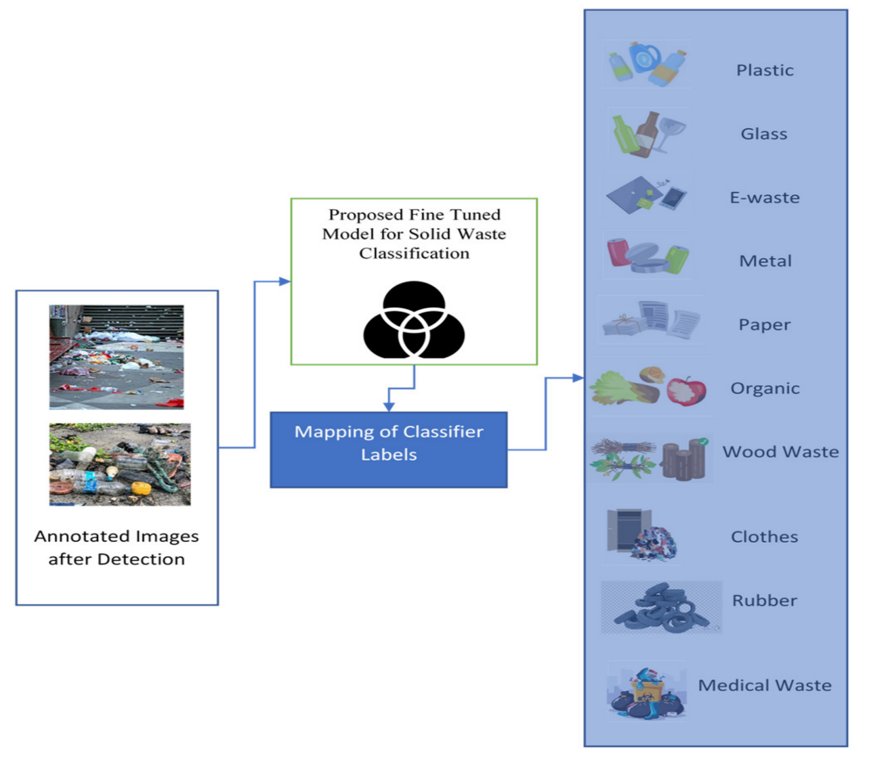
Pre Processing
The raw images of the TrashNet dataset are resized to the standard dimension of 299x299x3 since it is required in relation to the input layer in The architecture of deep learning InceptionV3[1]. – Data Augmentation: Class imbalance and other problems can be treated using various methods of data augmentation. For this purpose, flipping, rotation, and zooming have been performed to increase artificially the size and variability of the dataset[2]. – Unplanned Oversampling: This is going to solve the issue of class disparity by giving more representation of the underrepresented classes, that is, the trash classes. Therefore, the model will not be biased towards those classes which dominate the training[3].
Review No.
Department of CSE

Slide 14
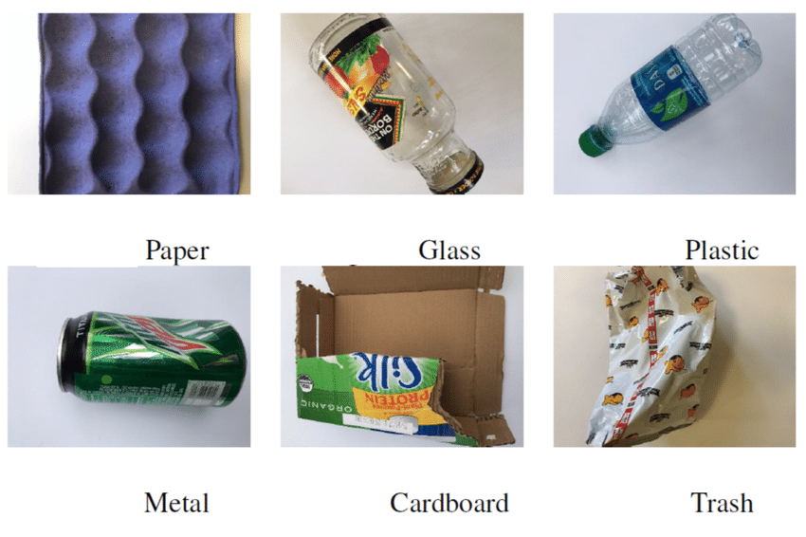
Pre Processing
Preprocessing Techniques:
Resizing Images: The raw images from the TrashNet dataset are resized to the standard dimension of 299x299x3. This resizing aligns with the input layer requirements of the InceptionV3 deep learning architecture.
Data Augmentation: To address class imbalance and enhance the dataset's variability, several data augmentation techniques are applied, including:
Flipping: Rotating images horizontally.
Rotation: Rotating the images to simulate different orientations.
Review No.
Department of CSE

Slide 15
Pre Processing
Feature Of Extraction:
Dataset Preprocessing:
The raw images in the TrashNet dataset are resized to a standardized dimension of 299x299x3, as required for the input layer of the InceptionV3 architecture.
Data Augmentation:
To combat issues like class imbalance, various data augmentation techniques are applied. These include:
Flipping
Rotation
Zooming
These techniques increase the dataset size artificially, introducing variability to help improve the generalization capability of the model.
Oversampling:
Oversampling is performed to mitigate class imbalance. Underrepresented classes, such as the "trash" class, are oversampled to ensure that the model is not biased toward the more frequent classes.

Slide 16
Feature Extraction from Pretrained Models:
The InceptionV3 architecture is employed for feature extraction. This model captures intricate image features at multiple scales, which helps improve classification accuracy.
The model extracts both coarse and fine-grained features from the images.
Hyperparameter Optimization (MBWO):
The Multi-Objective Beluga Whale Optimization (MBWO) method is used to optimize key hyperparameters (such as learning rate, dropout rate, and batch size) for better performance in waste classification tasks.

Slide 17
METHODOLOGY
1. Dataset Selection and Preprocessing
The TrashNet dataset was selected for the project, containing 2,573 images of waste materials categorized into cardboard, glass, metal, paper, plastic, and trash.
The dataset was split into training (70%), validation (15%), and testing (15%).
Class imbalance was addressed using data augmentation (flipping, rotation, zooming) and oversampling to improve model generalization.
2. Model Selection and Training
Several deep learning models were compared, including InceptionV3, MobileNetV2, VGG16, and AlexNet.
InceptionV3 was chosen as the primary model due to its superior accuracy and efficiency.
Hyperparameters like batch size, learning rate, and dropout rate were optimized using Multi-Objective Beluga Whale Optimization (MOBWO).

Slide 18
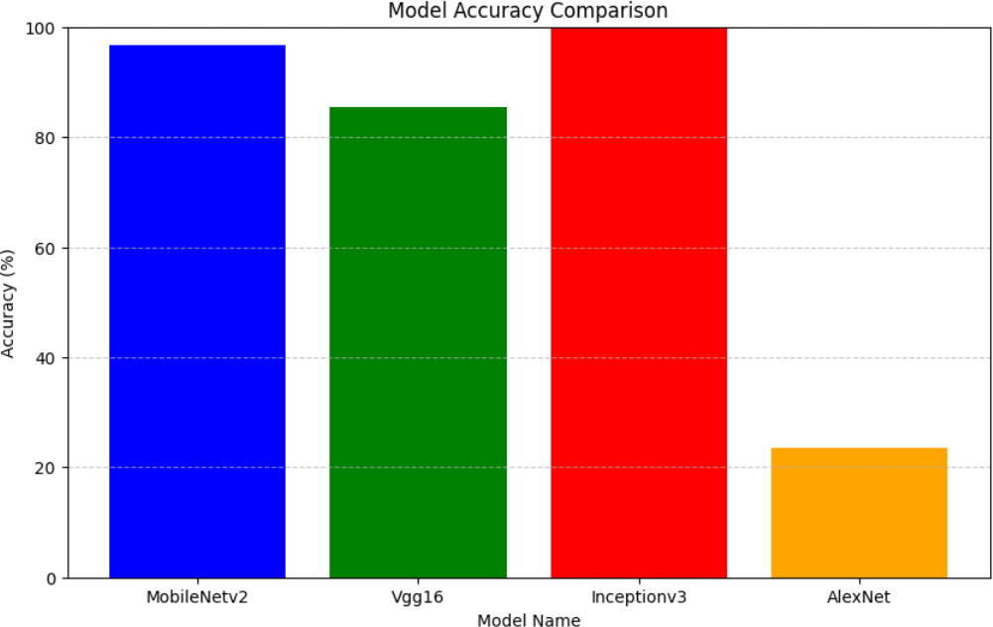
Comparative Analysis
In contrast, the highest accuracy was achieved by InceptionV3 with 99.70% accuracy; it had excellent precision, recall, and F1-score. The best model for the given task is, thus, InceptionV3. MobileNetV2 attained an accuracy of 97.84%, balancing accuracy and efficiency, thereby being suitable for scenarios where computational resources are rather limited. VGG16 offers fairly good performance, but it is slower; accuracy is at 85.43%.

Slide 19
METHODS and MODELS
Models Used:
InceptionV3:
A deep CNN with 42 layers optimized for image classification.
Achieved 99.70% accuracy.
Best model for waste classification based on precision, recall, and F1-score.
MobileNetV2:
Optimized for mobile applications.
Achieved 97.84% accuracy, balancing efficiency and accuracy.
VGG16:
A 16-layer deep CNN using 3x3 convolutional filters.
Moderate accuracy of 85.43%, but computationally expensive.
AlexNet:
A 5-layer CNN with ReLU activation and max pooling.
Lowest accuracy (57.61%), making it less suitable for waste classification.
Model Name | Accuracy
InceptionV3 | 99.70%
MobileNetV2 | 97.84%
VGG16 | 85.43%
AlexNet | 57.61%

Slide 20
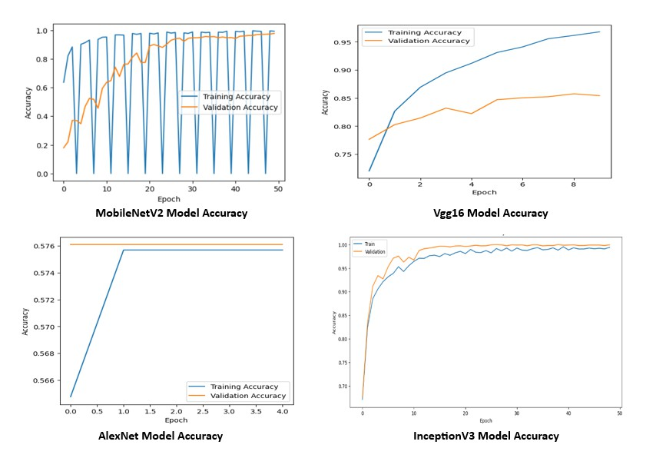
RESULTS & ANALYSIS
TRAINING AND TESTING ACCURACY OF MODELS

Slide 21
Model Name | Trainable Parameters | Testable Parameters
InceptionV3 | 23.9 million | 27.2 million
MobileNetV2 | 2.2 million | 3.5 million
VGG16 | 138 million | 138 million
AlexNet | 61 million | 61 million
Classes | Precision | Recall | F1 Score | Support
Cardboard | 1.00 | 1.00 | 1.00 | 4411
Glass | 1.00 | 0.98 | 1.00 | 976
Metal | 1.00 | 0.99 | 1.00 | 1010
Paper | 1.00 | 1.00 | 0.98 | 237
Plastic | 0.99 | 1.00 | 0.99 | 200
Trash | 0.99 | 0.98 | 0.98 | 827
Accuracy | 0.99
Macro avg | 0.98 | 1.00 | 0.98 | 7661
Weighted avg | 0.98 | 0.99 | 0.99 | 7661
Table 1: Trainable and Testable Parameters of Different Models
Table 2: Precision, Recall, F1 Score, and Support for Waste Classification

Slide 22
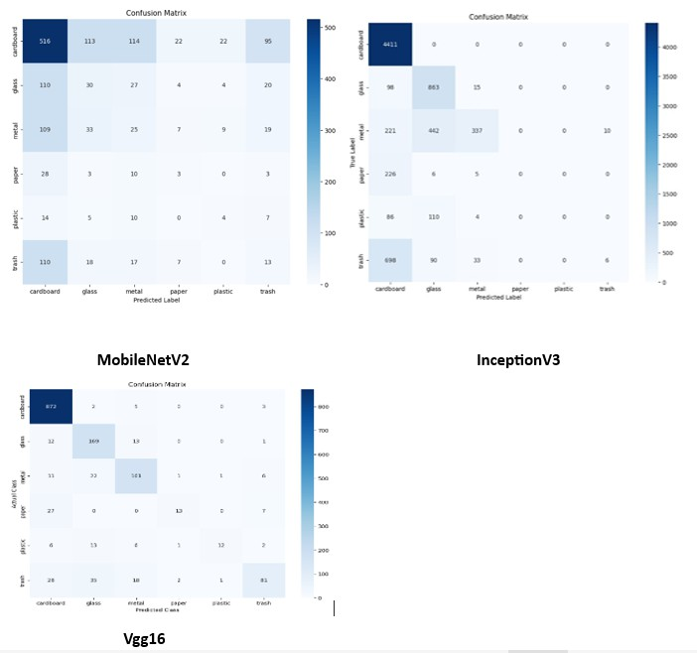
Fig:1 InceptionV3,MobileNetV2,Vgg16

Slide 23
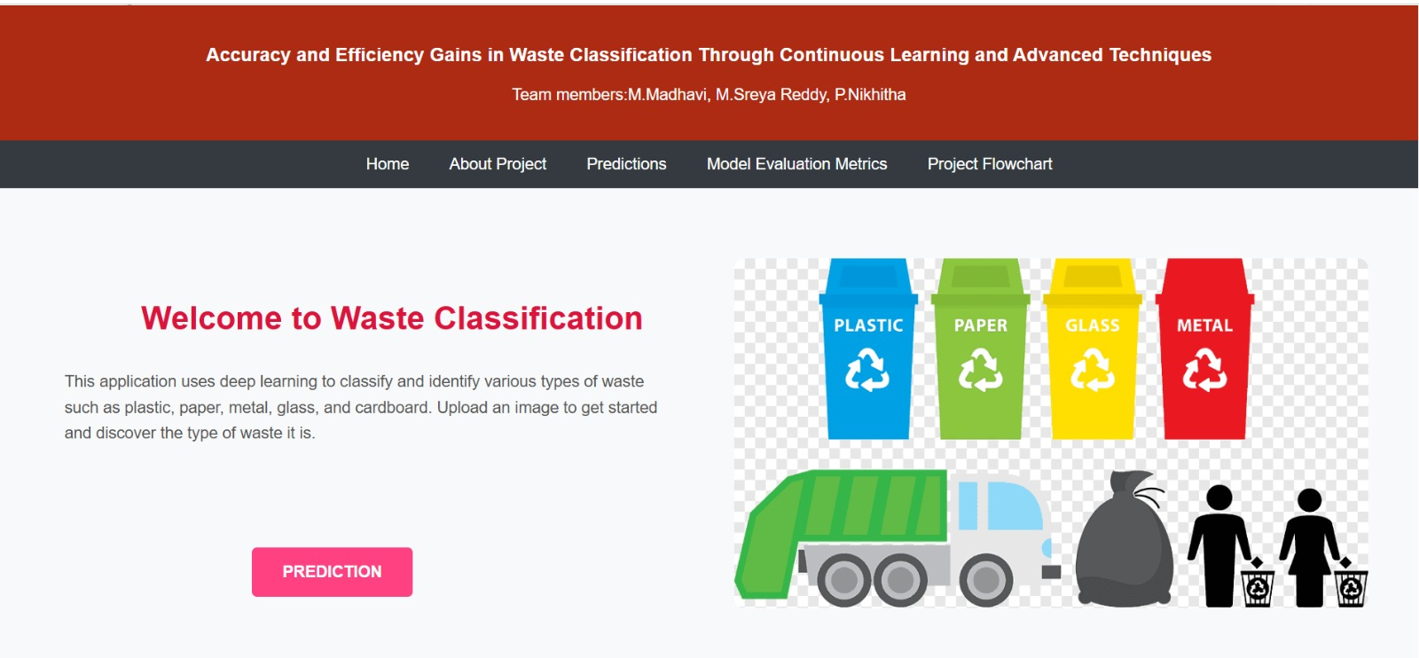
FrontEnd Screens

Slide 24
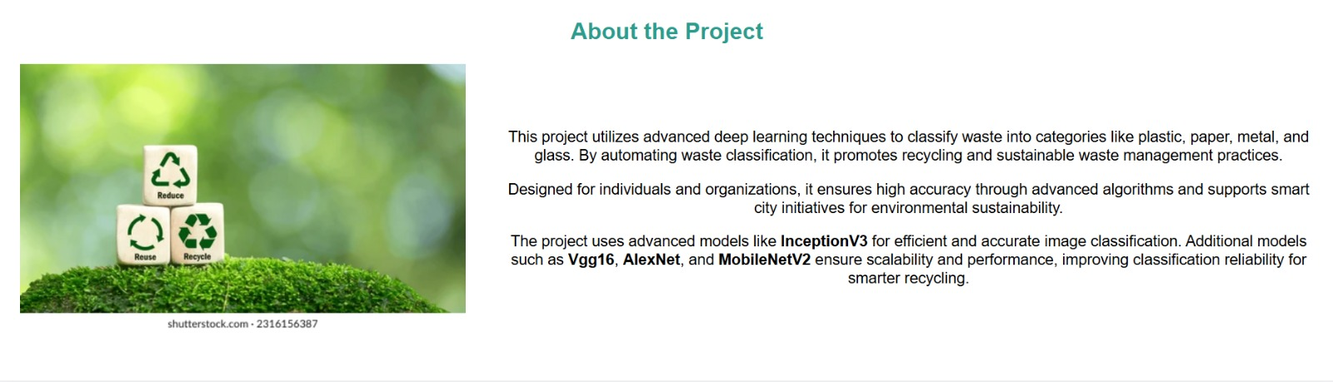
The above image shows the project using the advanced deep learning techinques to classify waste into categories like plastic, paper metal and glass

Slide 25
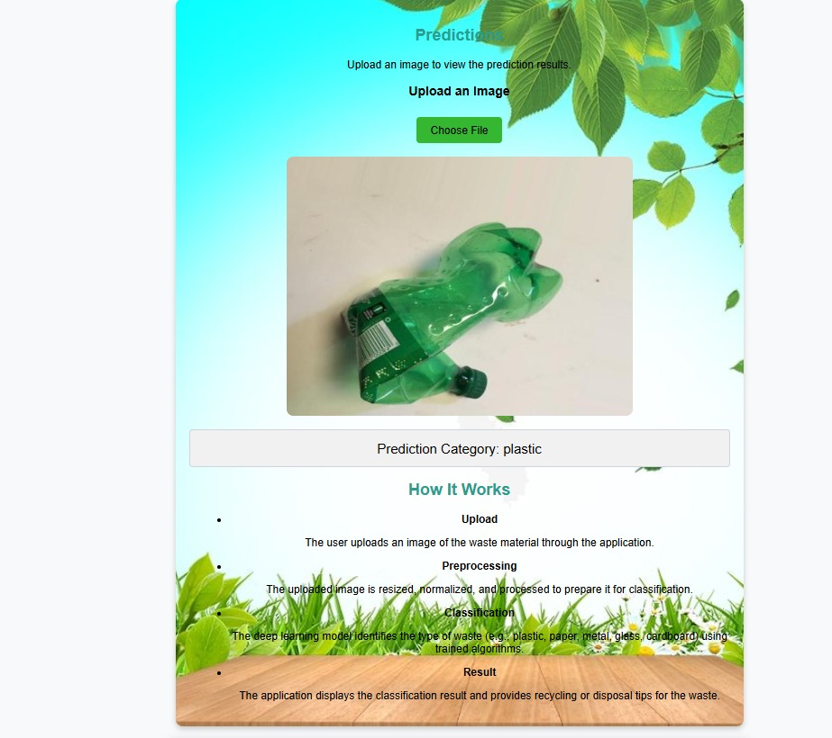

Slide 26
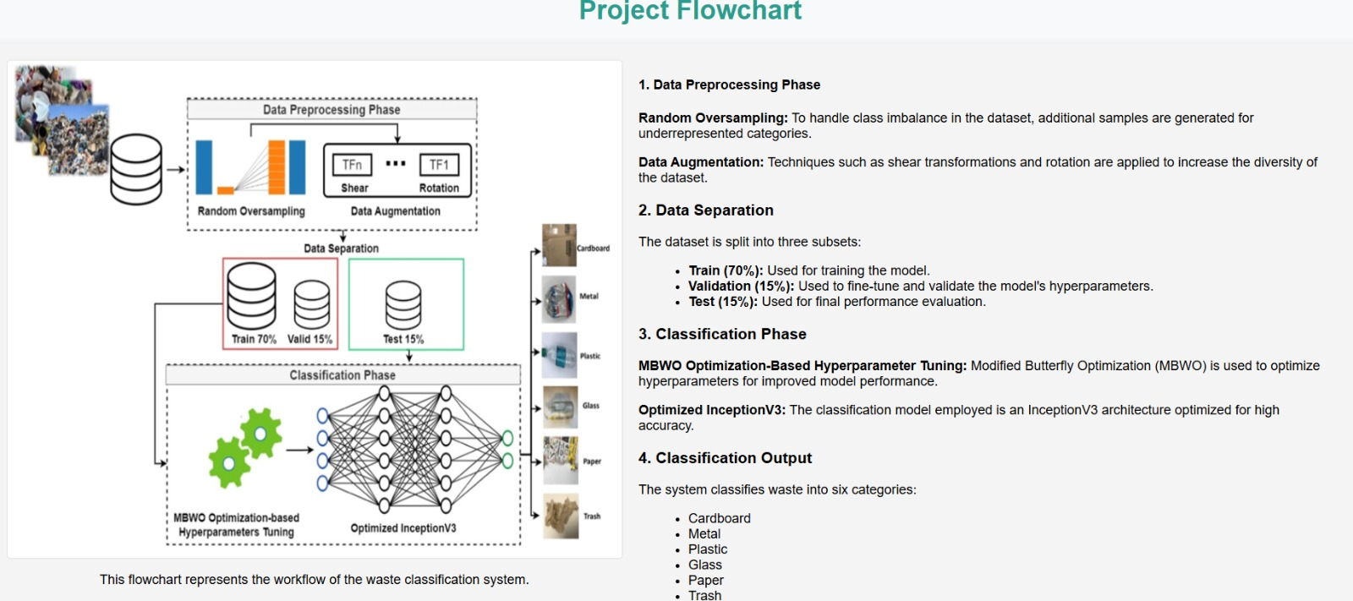

Slide 27
Conclusion and FutureScope
1. High Classification Accuracy: The proposed waste classification system, utilizing InceptionV3 with Multi-Objective Beluga Whale Optimization (MOBWO), achieved an impressive accuracy of 97.75%, significantly outperforming traditional methods in terms of classification precision.
2. Effective Handling of Class Imbalance: The system effectively addresses class imbalance problems by incorporating data augmentation and oversampling techniques, which improve model generalization and enhance the overall performance of waste classification.
3. calability and Adaptability: The solution is highly scalable and adaptable to real-world scenarios. It offers potential integration into smart city infrastructures and other large-scale waste management systems, contributing to sustainability efforts.
4. Future Improvements: Future work will focus on expanding the dataset, implementing real-time waste classification, and enhancing the model's scalability for broader environmental applications, ensuring the system remains effective in addressing global waste management challenges.

Slide 28
REFRENCES
1. Bobe, S., Adhav, P., Bhalerao, O., & Chaware, S. (2023, July). Review on Deep Learning Based Biomedical Waste Detection and Classification. In 2023 2nd International Conference on Edge Computing and Applications (ICECAA) (pp. 1071-1076). IEEE.
2. Rahmad, M. A., Midi, N. S., Zaini, S. A., Yusoff, S. H., & Mohamad, S. Y. (2018, September). Material classification of recyclable waste using the weight and size of waste. In 2018 7th International Conference on Computer and Communication Engineering (ICCCE) (pp. 44-49). IEEE.
3. Tripathi, R., Shetty, H., Patil, K., Ingawale, P., & Trivedi, M. (2023, October). Intelligent Waste Material Classification Using EfficientNet-B3 Convolutional Neural Network for Enhanced Waste Management. In 2023 International Conference on Self Sustainable Artificial Intelligence Systems (ICSSAS) (pp. 132-137). IEEE.
4. M. Sireesha, S. N. TirumalaRao, Srikanth Vemuru, Frequent Itemset Mining Algorithms: A Survey Journal of Theoretical and Applied Information Technology Vol - 96, No. 3, Feb - 2018 ISSN - 1992-8645, Pages – 744 – 755

Slide 29

QUESTIONS and ANSWERS
Review No.
Department of CSE

Slide 30

ACKNOWLEGEMENTS
Presented By
M.Sreya Reddy (21471A05N8)
M.Madhavi (2247A0522)
P.Nikhitha (2247A0504)
Review No.
Department of CSE

